Slide 1

ELLIPTIC CURVE DIGITAL SIGNATURE ALGORITHM Cryptography Foundation
[887689] Brahmashwini Regonda
[887820] Zhibek Turikpenova
[888394] Muhammad Tajwar
May 25th,2021

Slide 2

Introduction to Cryptography
Cryptography is a method of storing and transmittig data in a secured form so that only those for whom it is intended can read and process it.
In morden cryptography there are 2 main methods :
1.Symmetric-key cryptography.
2.Asymmetric-key cryptography.

Slide 3
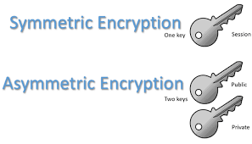
Introduction to Cryptography
The main disadvantage of using symmetric key is the need to keep the key secret and this can be especially a challenging task where encryption and decryption takes place in different locations with the same key.
But asymmetric cryptography offers better security as it uses two different keys i.e., public and private where the secret key will never be shared to any others to decrypt the message.

Slide 4
Introduction to Cryptography
Popular public-key cryptography algorithms are:
Diffie Hellman
RSA
Elliptic curve cryptography

Slide 5
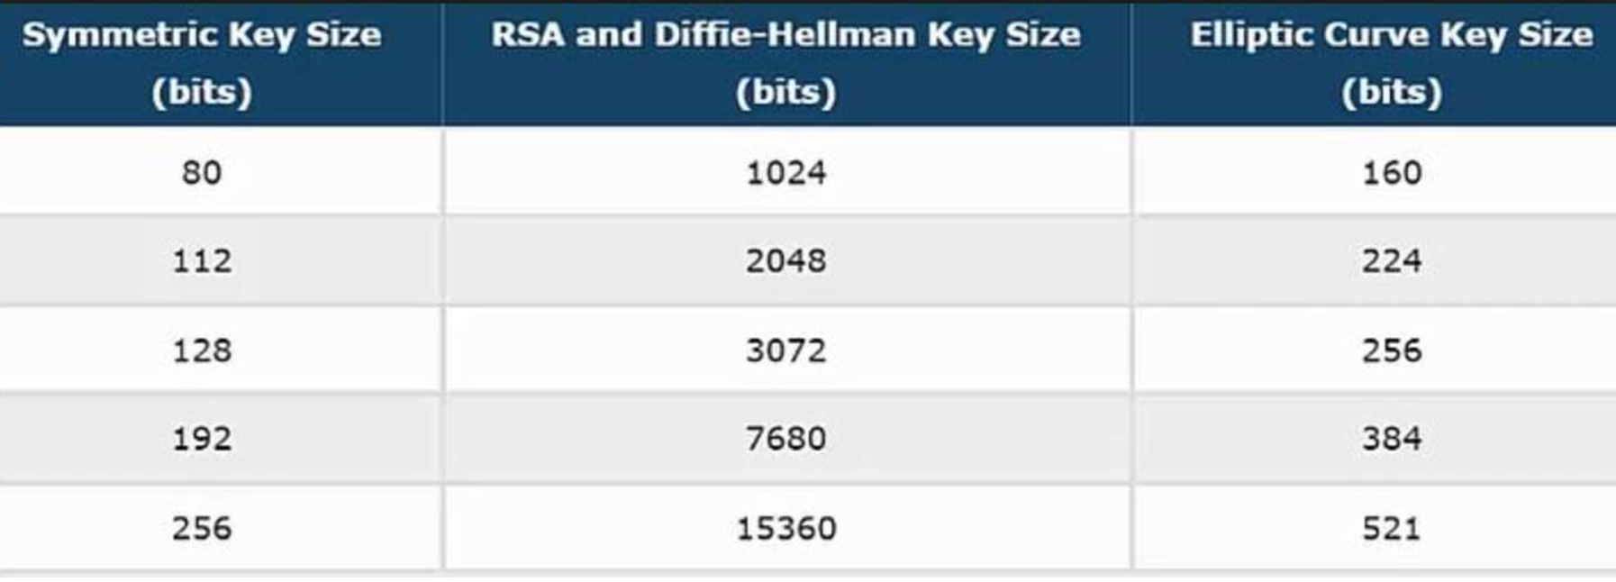
Elliptic Curve vs RSA
ECC is frequently discussed in context of RSA. It achieves encryption of things using prime factorization.
ECC is an alternative technique to RSA for its powerful approach as it provides equal security with smaller key compared to RSA and also non ECC as it provides high security with small key size
A 256-bit ECC pubic key provides comparable security to a 3072 RSA public key.
The primary advantage of using Elliptic Curve based cryptography is reduced key size.

Slide 6
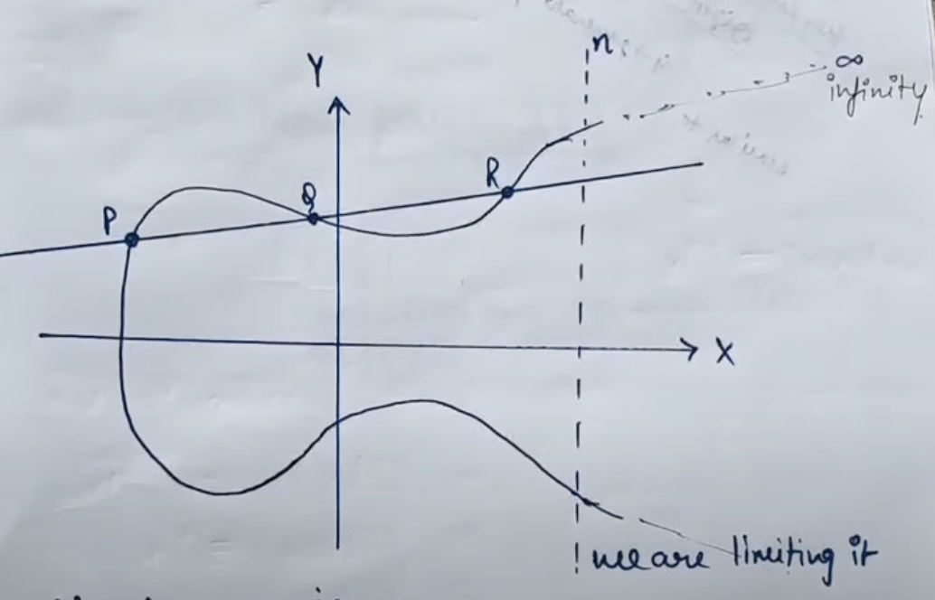
What is Elliptic Curve ?
In mathematics, Elliptic Curve(EC) is a subject of Algebraic Geometry.
Algebraic object because it uses cartesian co-ordinates to represent points on the EC as pair of numbers.
We draw EC in plane with cartesian co-ordinates and it is suitable curve in the plane.This makes elliptic curve a Geometrical object.
The curve is symmetric to x-axis. The area above x-axis is equal to area below x-axis.
If we draw a line on EC it will touch maximum of 3 points on the curve P,Q and R as shown in the figure.

Slide 7
Elliptic Curve Cryptography
Elliptic Curve Cryptography (ECC) is a public-key(asymmetric) cryptrography based on the algebraic structure of elliptic curve over finite fields.
The use Elliptic Curves (EC) was suggested in cryptrography around mid 1980’s and algorithms entered wide use in 2004 to 2005.
ECC allows smaller keys compared to non-ECC which provide equivalent security. So ECC is efficient in space and time.
ECC are applicable for encryption, digital signatures, pseudo-random generators and many other tasks.

Slide 8
Equation of an Elliptic Curve
An elliptic curve is a curve given by an equation of the form:
y² = x³ +ax+b
with:
a , b ∈ K
Where the discriminant: 𝝙 = 4a³ + 27b² is not equal to zero and gives 3 distinct roots. This ensure that the curve is non-singular. Non- singular means every point in elliptic curve has tangent line.
O is a point at “infinity”. It is at the end of all vertical lines. So E, is the set:
E = {(x,y) : y² = x³ +ax+b}∪{O}

Slide 9
Points on Elliptic Curve
When we have polynomial describing elliptic curve the coefficients of polynomial are numbers which can be expressed in any field like F_{P}, Q, R and C.
If field is changed then we get group operations over the points of the EC.
Finite fields are integer mod p (prime number) and curves with points in F_{P} are called finite groups.
Elliptic Curve Discrete Logarithm Problem (ECDLP) is the discrete logarithm problem for the group of points on an elliptic curve over finite field.
The best algorithm to solve this ECDLP is exponential.
Every point in EC has a tangent line.

Slide 10
Trap Door Function
A Trap door function is a function that is easy to compute in one direction yet difficult to compute in the oppsite direction(inverse) without special information is called trapdoor.
x
easy
F(x)
hard
Easy if given
“T”→ trapdoor value

Slide 11
GEOMETRY
OF
ELLPTIC CURVE

Slide 12
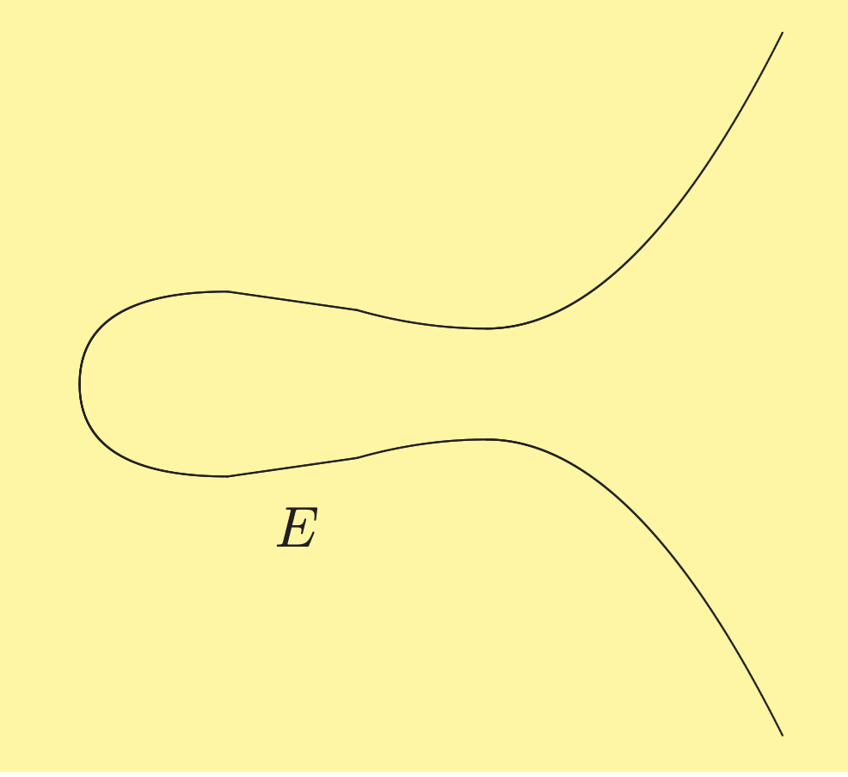
Elliptic Curve:Example
Let us consider the Elliptic Curve.
E: y²=x³-5x+8

Slide 13
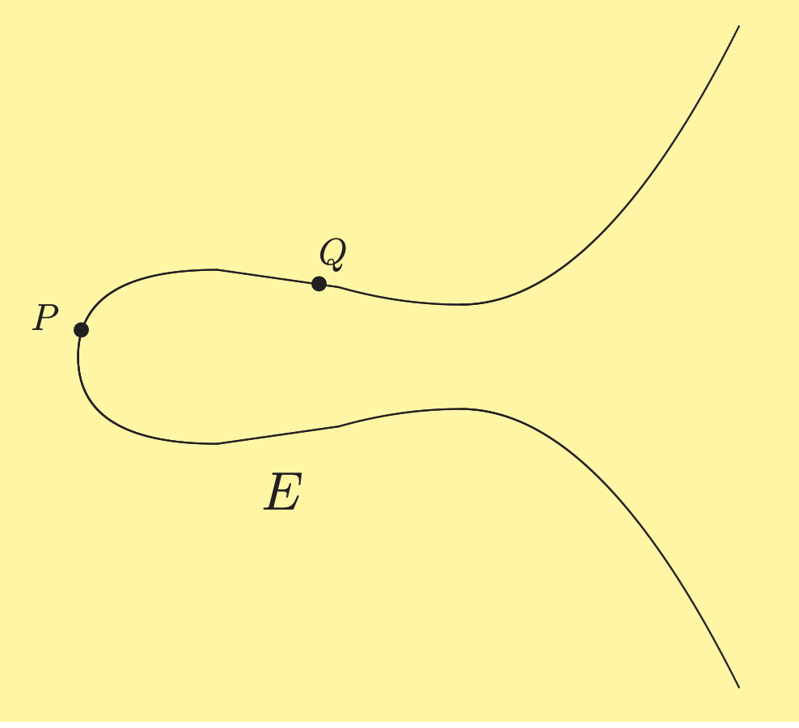
Elliptic Curve: Adding two points (1/5)
Let us consider 2 distinct points P and Q in the EC and we need to add this 2 points. Start with two points P and Q on EC.

Slide 14
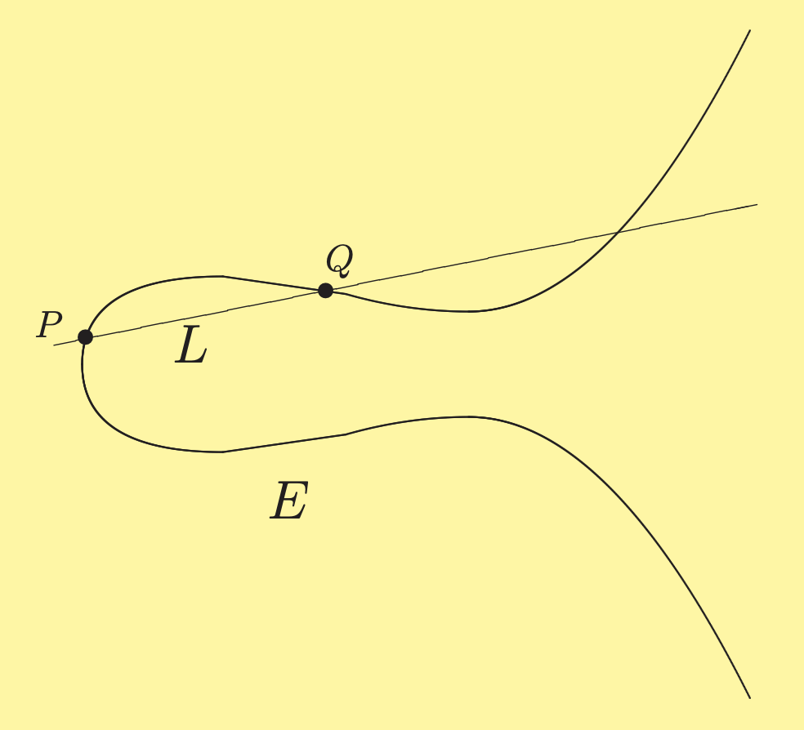
Elliptic Curve:Adding two point (2/5)
Next draw a line L connecting P and Q.

Slide 15
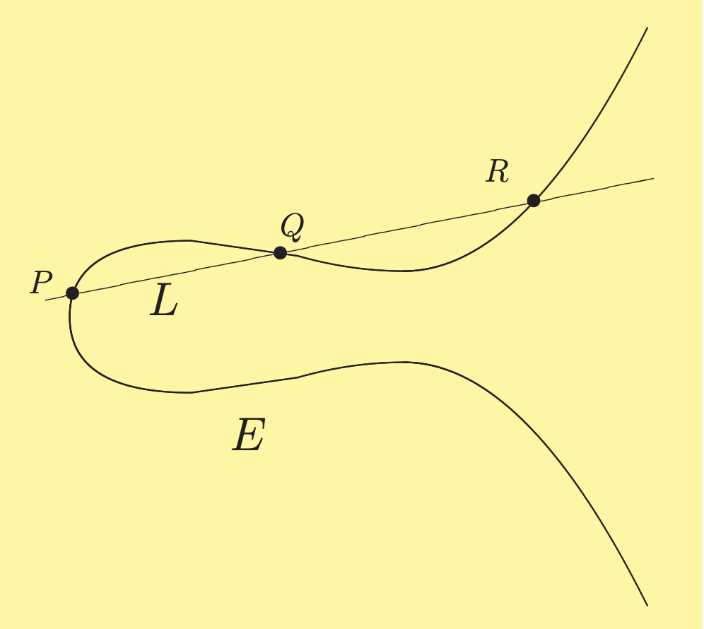
Elliptic Curve:Adding two points (3/5)
The line L intersects the EC in an another point R.

Slide 16
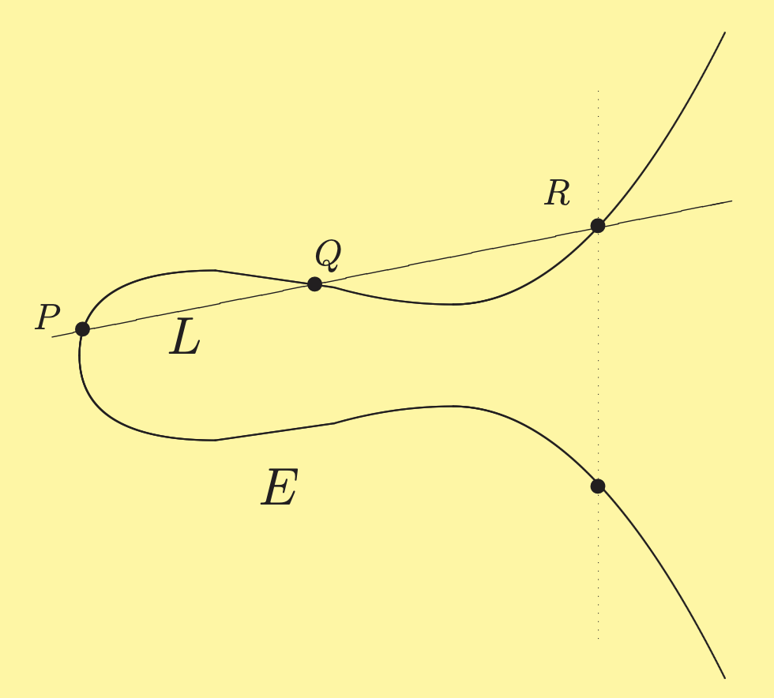
Elliptic Curve: Adding two points (4/5)
Draw the vertical line through R it hits EC in another point.
Note: By defination P*Q=R. But this is not a group operation so consider the reflecting point of R.

Slide 17
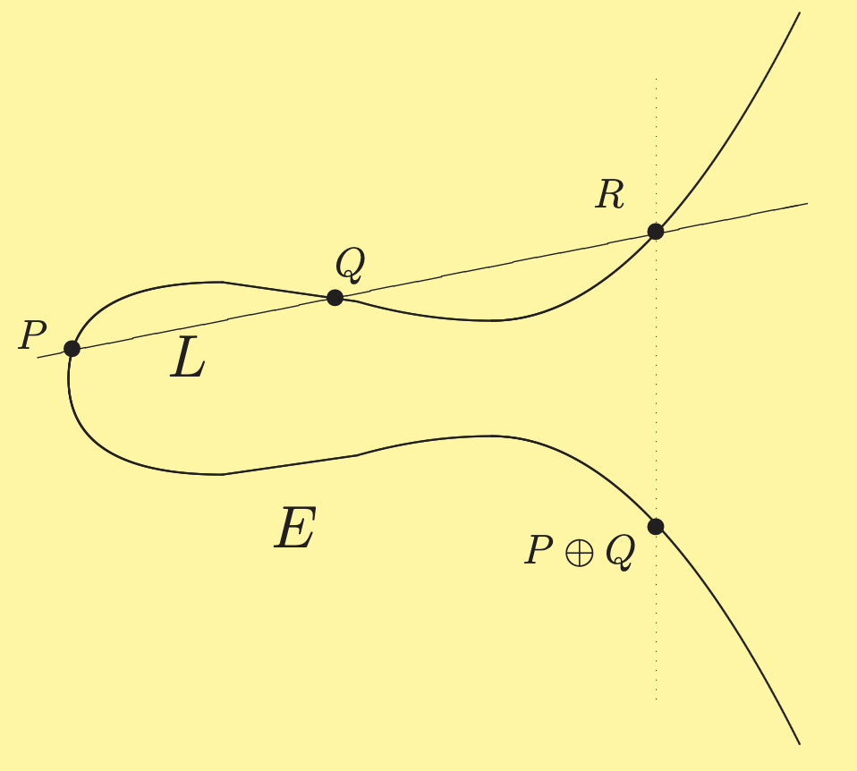
Elliptic Curve: Adding two points (5/5)
We define the sum of P and Q on E to be the reflected point.
we denote it by P ⊕ Q or just P + Q
Note: 1.A line parallel to Y-axis crosses R and another point P+Q which is symmetric to x-axis.
2.P+Q is the reflected point of R=P*Q

Slide 18
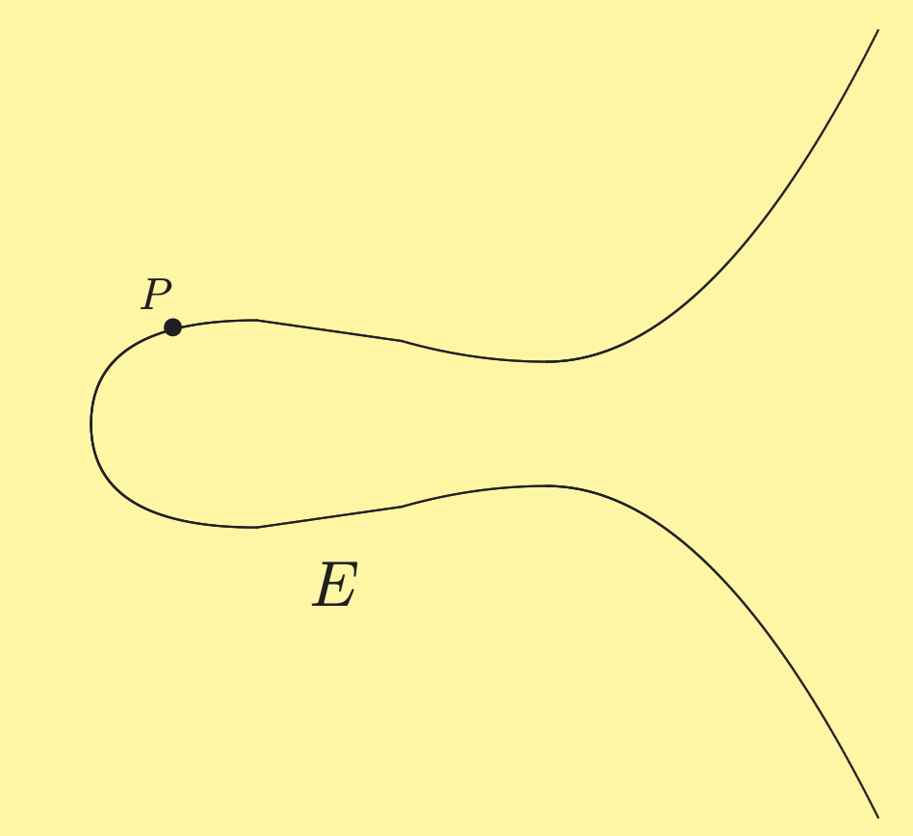
Elliptic Curve:Adding a point to itself (1/3)
How do we add a point P to itself (P+P), since there are many different lines that go through P?
Note: As we know Elliptic curve is a non-singular cubic which means we get a tangent line at every point. So use tangent line to add point to itself.

Slide 19
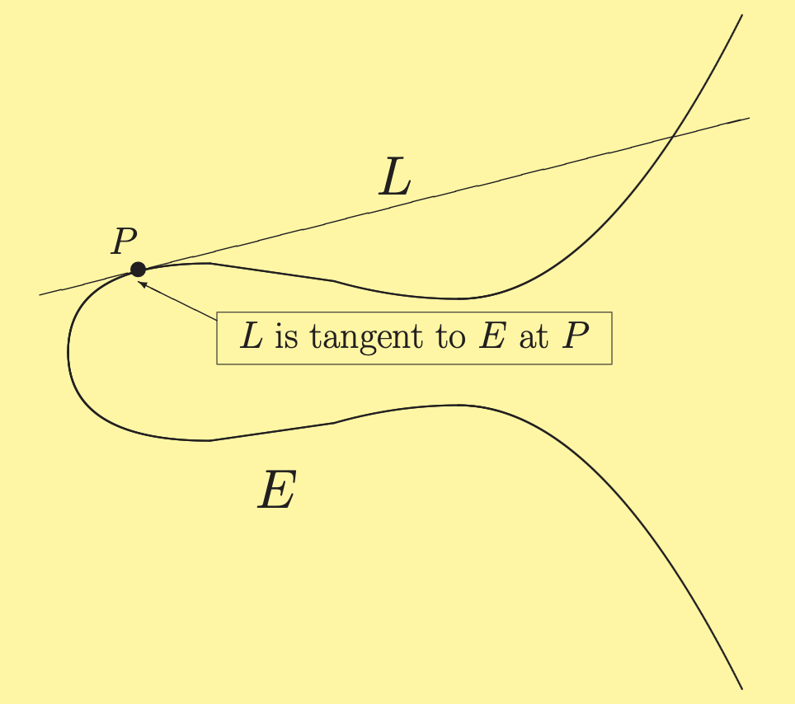
Elliptic Curve:Adding a point to itself (2/3)
We fix P. Then the line L becomes the tangent line to EC at P.
The tangent line intersect at EC 2 times at P and another point in EC.

Slide 20
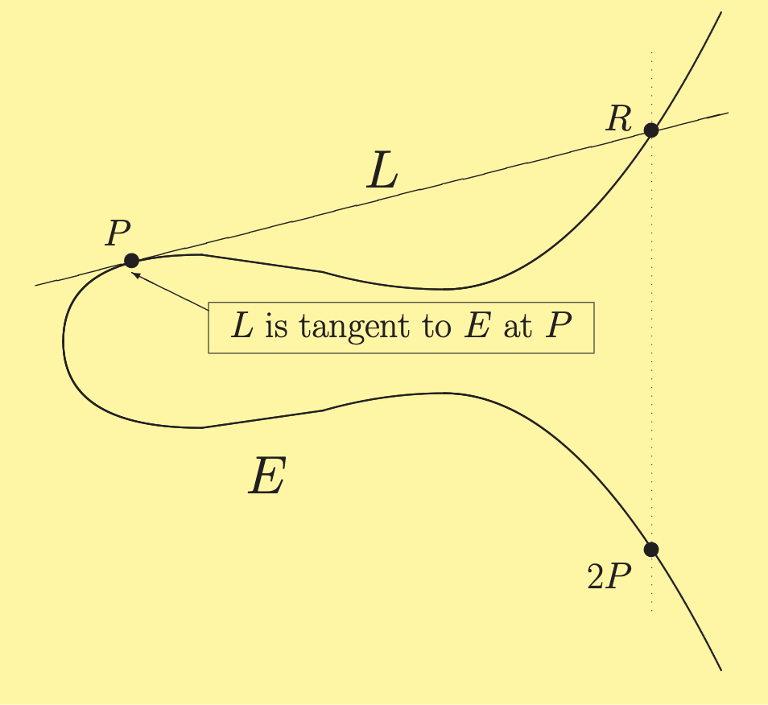
Elliptic Curve:Adding a point to itself (3/3)
Finally, take the third intersection point at R and then consider the resulting reflecting point as P ⊕ P or 2P across the x-axis.

Slide 21
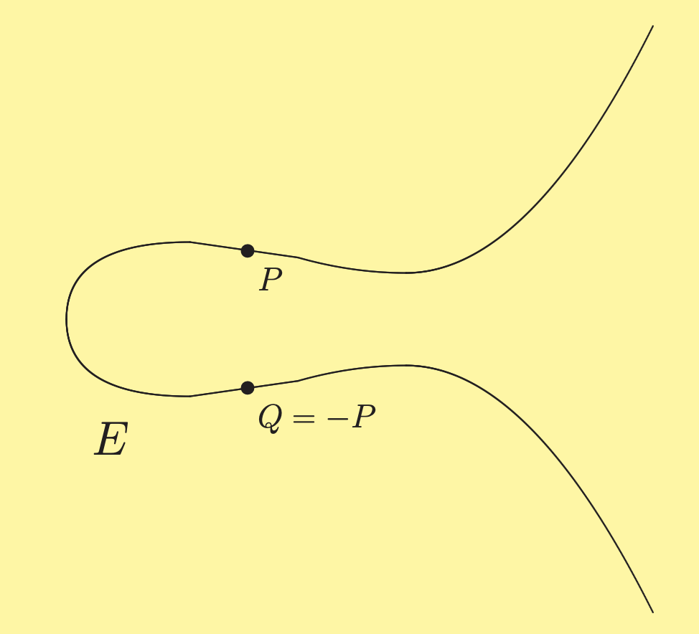
Elliptic Curve:Vertical Lines (1/3)
Let us consider a point P on E and denote the reflected point as -P .

Slide 22
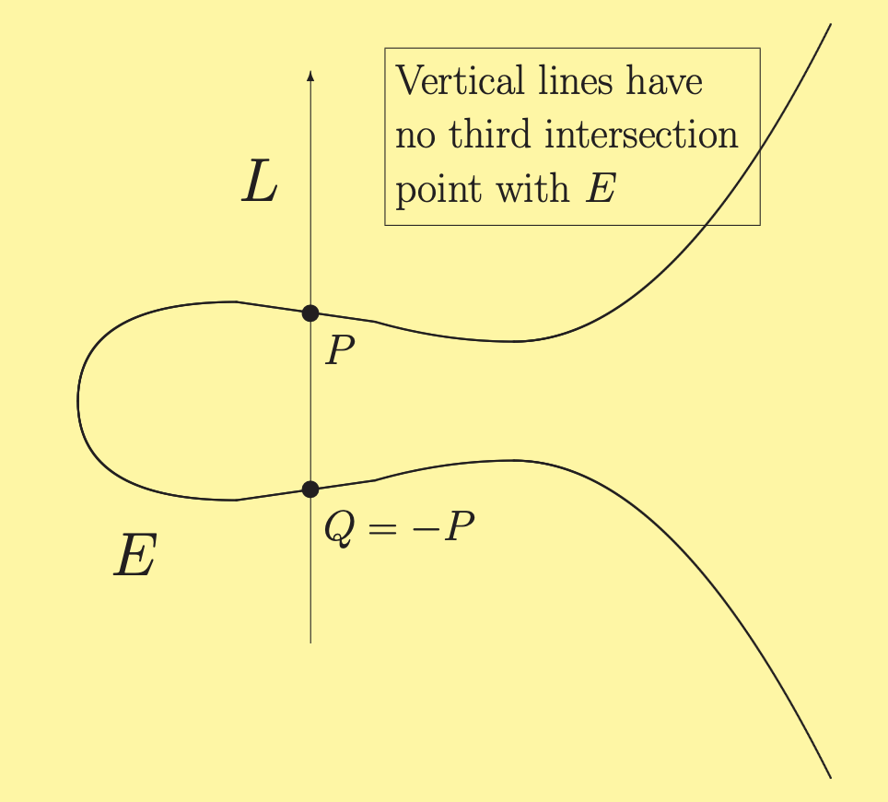
Elliptic Curve: Vertical Lines (2/3)
The line connecting the 2 points is parallel to Y-axis, but we require at least 3 points.
So here we have a Problem: The Vertical lines have no third intersection point with E
We need a third point to define P ⊕ (-P)

Slide 23
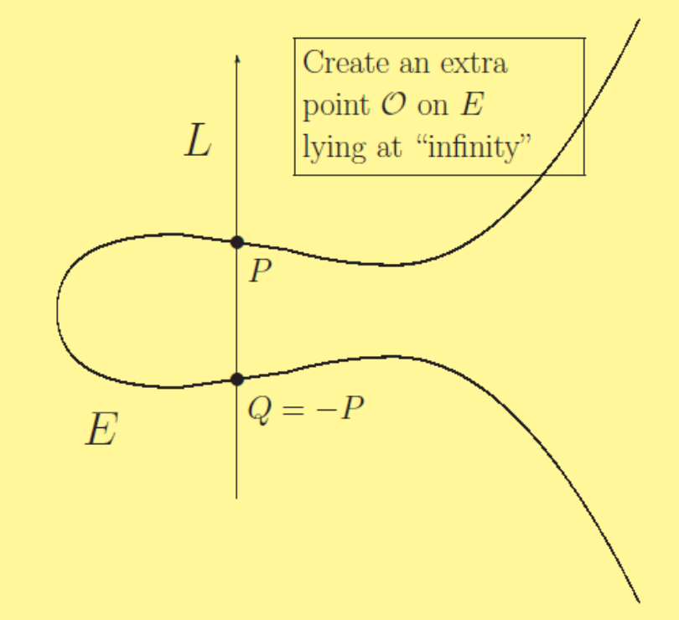
Elliptic Curve:Vertical Lines (3/3)
Solution: We create an extra point O “at infinity” that belongs to every vertical line
So P+(-P)=O

Slide 24
Algebra of
Elliptic Curve

Slide 25
Addition on Elliptic Curve
The groups of EC are Commutative, Associative and Neutral Element.
Addition operation on points in elliptic curve satisfies group laws. In other words addition law (+) makes the points on E into commutative.
P+Q=Q+P for all P, Q in E Commutative Group
P+O=O+P=P ‘O’ is a Neutral Element.
P+(Q+R)=(P+Q)+R for all P,Q,R in E Associative Group
For every point in EC their exist an opposite point.
For example ‘P’ is a point on EC then ‘–P’ is an opposite point/reflected point.
P+(-P)=O for all P in E

Slide 26
Elliptic Curve over Finite Fields (F_{p}/Z_{p} )
A finite field is a field with finite number of elements, defined by parameter p, which is a prime number
When the coefficients of the curve are integers we read the curve in finite fields
Thus the finite field F_{P} ={0,…….p-1}
This means that modulo p should be used in the equation:
The EC equation: y²=x³+Ax+B
The EC equation with modulo operation y²=x³+Ax+B (mod P)

Slide 27
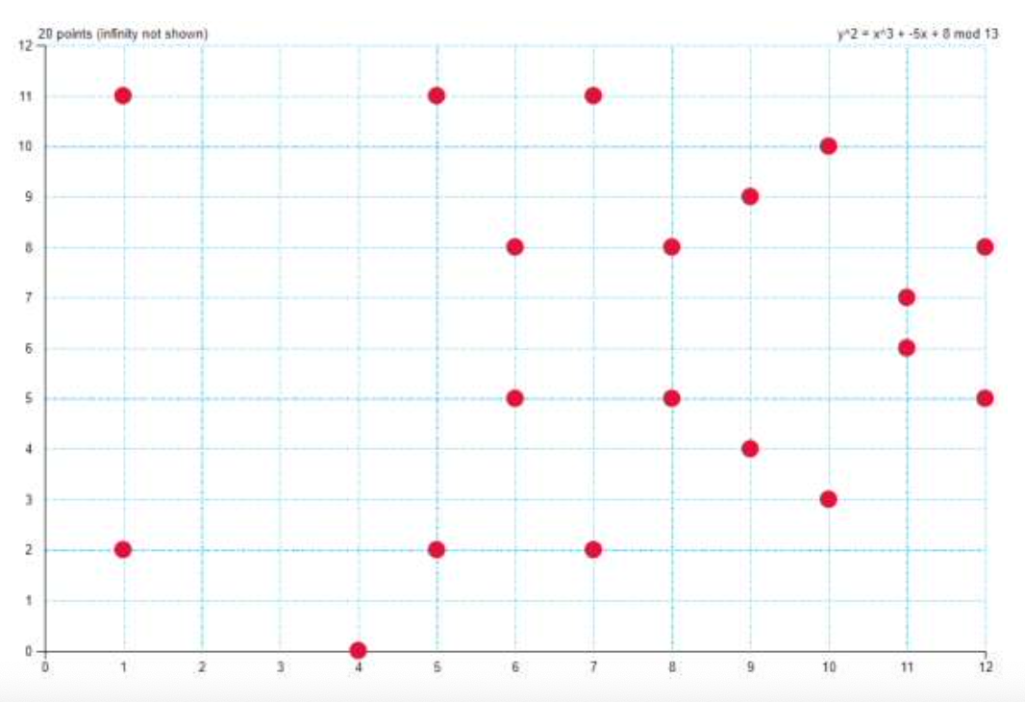
Elliptic Curve over Finite Fields:Example
Let us consider the Elliptic Curve E over the finite Fields F₁₃
Y²=X³-5X+8 (mod 13)
In the first position it will have 13 possibilities and in the second position it will have 13 possibilities all the numbers between 0 to 12.
In total it will have square 13 possible pairs. But some are points on the elliptic curve and some are not point on the EC.
It is finite because we get finite number of pairs.
In this way we can store all the points of the curve in a certain maximum number of bits.

Slide 28
Elliptic Curves
Weierstrass form: y² = x³ + ax + b
Koblitz curves : y² + xy = x³ + ax² + b
Upto now we have seen operations and graphs of kind of Weierstrass.
Koblitz Curves: They are different from Weierstrass equation and they are not symmetric to x-axis. It will be convolved as you can see in next slide.

Slide 29
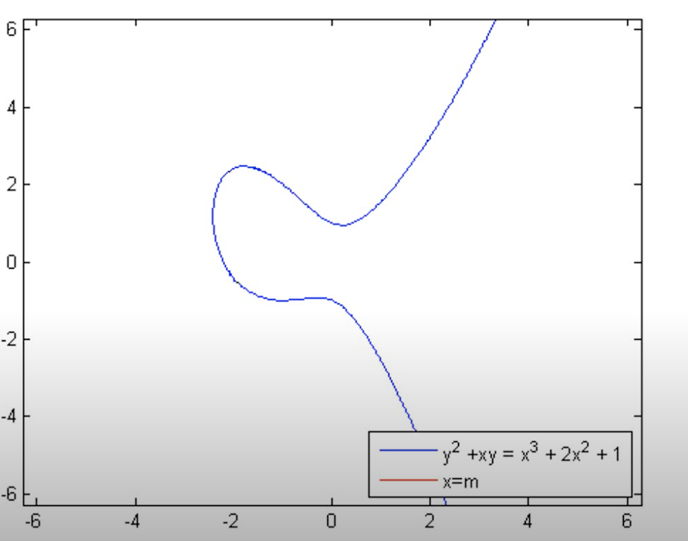
Koblitz Curve: Example

Slide 30
secp256k1
The standards for efficient crytography group has published recommended set of elliptic curve domain parameters which are referred by the letters p,a,b,G,n,h.
The sextuple data set T= {p,a,b,G,n,h} is collectively referred to as the recommended Elliptic Curve Domain Parameters.
These parameters have been given nicknames to enable them easily identified
For example:secp256k1 associated with Koblitz curve.

Slide 31
Elliptic Curve Domain Parameters
In this table you will find set of elliptic curve domain parameters.
The elliptic curve uses smaller key sizes with respect to RSA providing comparable security.

Slide 32
SECP256K1:Parameter Values
Secp256k1 uses the parametersand it is defined as below :
p = 2²⁵⁶ − 2³² − 2⁹ − 2⁸ − 2⁷ − 2⁶ − 2⁴ − 1
p = FFFFFFFF FFFFFFFF FFFFFFFF FFFFFFFF FFFFFFFF FFFFFFFF FFFFFFFE FFFFFC2F
The base point G, also known as the generator or primitive element is predetermined point (X_{G} , Y_{G}) on the elliptic curve that everyone uses to compute
other points on the curve. It is displayed in 2 ways:
Compressed form: (prefix 02)
G = 02 79BE667E F9DCBBAC 55A06295 CE870B07 029BFCDB 2DCE28D9 59F2815B 16F81798 (If we remove 02 then it is X_{G} and to get Y_{G} = (X_{G} +7)^{1/2} )
Uncompressed form: (prefix 04)
G = 04 79BE667E F9DCBBAC 55A06295 CE870B07 029BFCDB 2DCE28D9 59F2815B 16F81798 483ADA77 26A3C465 5DA4FBFC 0E1108A8 FD17B448 A6855419 9C47D08F FB10D4B8(If we 04 then it is is X_{G} )

Slide 33
SECP256K1:Parameter Values
Order n of G and the cofactor are:
n = FFFFFFFF FFFFFFFF FFFFFFFF FFFFFFFE BAAEDCE6 AF48A03B BFD25E8C D0364141
h = 01
The E: y² = x³ + ax + b over Fp is defined by:
a = 00000000 00000000 00000000 00000000 00000000 00000000 00000000 00000000
b = 00000000 00000000 00000000 00000000 00000000 00000000 00000000 00000007

Slide 34
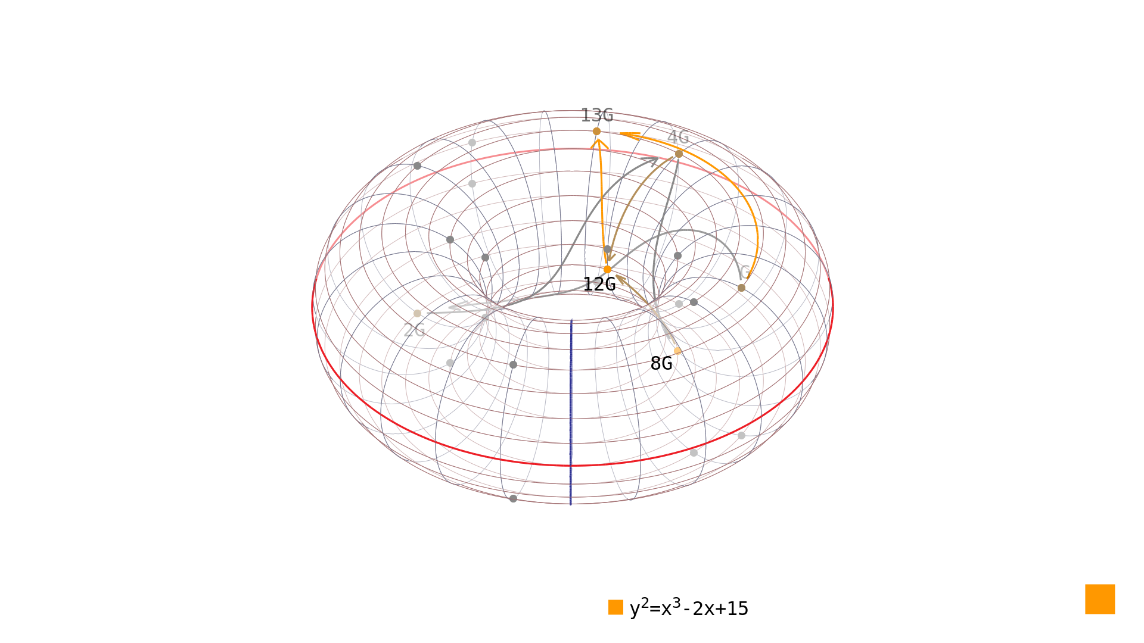
Elliptic Curve Discrete Logarithm Problem

Slide 35
Discrete Logarithm Problem
Let E be an elliptic curve defined over a finite field Fp.
E : y2 = x3 + Ax + B A, B ∈ Fp :
Let S and T be points in E(Fp). Find an integer m so that
T = mS
where m is the muliplier that tell how many times S been added to itself and even if we knew the value of T and S we cant find the integer m andthis is called Discrete Logarithm Problem

Slide 36
Example
In the elliptic curve group defined by y2 = x3 + 9x + 17 over F23
What is the discrete logarithm k of Q = (4,5) to the base P = (16,5)?
One way to find k is to compute multiples of P until Q is found. The first few multiples of P are:
P = (16,5) 2P = (20,20) 3P = (14,14) 4P = (19,20) 5P = (13,10) 6P = (7,3) 7P = (8,7) 8P = (12,17) 9P = (4,5)
Since 9P = (4,5) = Q, the discrete logarithm of Q to the base P is k = 9. In a real application, k would be large enough such that it would be infeasible to determine k in this manner

Slide 37
How To Solve ECDLP?
Exhaustive Search Method
Compute m1S, m2S, m3S for randomly chosen values m1, m2 ,m3 until you find a multiple with mS = T. Expected running time is O(p), since E(Fp) = O(p) and this also called Brute Force Technique

Slide 38
Collision Search Method
It is also known as Baby Steps Giant Steps and it is a meet-in-the-middle algorithm computing the discrete logarithm
This method was developed by D. Shanks requires N steps and N storage.
The algorithm is based on a space time trade off. It is a fairly simple modification of trial multiplication, the naive method of finding discrete logarithms. Expected running time is O(√p ) by the birthday paradox

Slide 39
Example 1/2
α.G = A β.G = B
Lets say Attackers knows that the elliptic curve equation is y^2mod17 = x^3 + 2x + 2 and he know the generator point is G:(5,1), order of G is n=19 and cofactor is 1 and also know A and B which is A(10,6) B(7,6)

Slide 40
Example 2/2
Pick an integer m > √n where n is the order of the cyclic group
Lets say he picks m=5 which is valid
Then he computes mG which is 5G = (9,16)
For i=0 to i=m-1 , Compute and store i.G 0.G = 0 1.G = (5,1) 2.G = (6,3) 3.G = (10,6) 4.G =(3,1)
for j=0 to j=m-1, compute and store A(or B) -j.mG (10,6)-0.5.G=(10,6)-0G=(10,6) (10,6)-1.5.G=(10,6)-5G=(10,6)-(9,16)=(6,14) and so on
After computing all he makes the lists List 1 :(5,1),(6,3),(10,6),(3,1) List 2 :(10,6),(6,14),(0,11),(0,6)
Then he compare the value and found a match (10,6) he remember the value for i and j (i=3,j=0)for which he computer (10,6) put in this α mod n = i+j.m which give you α mod 19 =3+0.5 α = 3

Slide 41
Pollards ρ Method
Pollards Method is actually works same as Collision method but in a optimized manner the collision method has running time O(√p) but for the storage of the two lists it take O(√p) space
Pollards ρ method also achieves the same O(√p) running time but requiring a very small amount of storage.
The idea is to traverse a “random” path through multiples mS + nT until finding a collision.
This path will consist of a loop with a tail attached (just like a ρ letter)

Slide 42
Example
Given
a finite set S
a map f:S → S
a starting point xo ∈ S
Let Xi+1 = f (xi) we are searching for a collision, i.e xi = Xj
One way to find a collision is store all x0, x1, . . . , xj
xj+1 = f (xj) and compare xj+1 with all x0, x1, . . . , xj
How to reduce memory ? Well if we check whether xi = x2i at each iteration, we will eventually find a collision.

Slide 43
How Else Can DLP Be Solved ?
Pollard’s ρ method works for most discrete log problems
For an abstract finite group G whose group law is given by a black box, one can prove that the fastest solution to the DLP has running time O(√G).
But for specific groups with known structure, there are often faster algorithms
For Z = NZ, the DLP is inversion modulo N. It takes O(log N) steps by the Euclidean algorithm
For R∗, the DLP can be solved using the standard logarithm if β = αm, then m = log(β)/log(α)
For F∗p, there is a subexponential algorithm called the Index Calculus that runs in (roughly)
O(e^c3√ logp) steps

Slide 44

Diffie-Hellman Key Exchange

Slide 45
Diffie-Hellman Key Exchange
Elliptic-curve Diffie–Hellman (ECDH) is a key agreement protocol that allows two parties, each having an elliptic-curve public–private key pair, to establish a shared secret over an insecure channel.
This shared secret may be directly used as a key, or to derive another key. The key, or the derived key, can then be used to encrypt subsequent communications using a symmetric-key cipher.
It is a variant of the Diffie–Hellman protocol using elliptic-curve cryptography

Slide 46
Diffie-Hellman Key Exchange Algorithm 1/2
Alice wants to communicate with bob on a unsecured channel and wanted to exchange keys by using Diffie Hellman Algorithm
They agreed on a Elliptic Curve equation y2 = x3 + ax + b modp
Generator of the curve lets say R = (Xr, Yr)
Now Alice will choose a number a from set { 2, 3, ...., |E| - 1} where |E| is cardinality of Elliptic Curve
Bob will choose a number b from set { 2, 3, ...., |E| - 1}
Alice now will computer her Public key Ka = aR
Bob will also computer his Public key Kb = bR
Now Alice and Bob will broadcast their public keys
Then Alice will compute her Common Private Key Kc = aKb using Bobs public key.
Bob do the same compute his Common Private Key Kc = bKa using Alice public key.
They will both compute their Public and Private keys using Double and Add Algorithm

Slide 47
Diffie-Hellman Key Exchange Algorithm 2/2
Eve is now in the channel and she wants to know the communication between Alice and Bob
Eve knows the Elliptic curve equation she also know the generator value and the finite set and also alice, bob public key.
Only thing she have to compute is common key Kc = aKb = bKa
where a and b are secrets the only Alice and Bobs know
if she wants to know a she will try so solve this Ka = aR if she know a she will easily compute ka of course but if she know ka she cant easily find a she have to use Brute Force technique which takes a lot time (exponential time)

Slide 48
Example
The Elliptic Curve equation is y2 = x3 + 2x + 3 mod 17 and Generator is R=(5,11)
Alice
a=2
ka= 2.R = 2.(5, 11) = (15, 5)
kc= 2.kb = 2.(2, 10) = (14, 2)
Bob
b=5
kb = 5.R = 5.(5, 11) = (2, 10)
kc= 5.ka = 5.(15, 5) = (14, 2)
Now the Alice and Bob can select either x coordinate of common key (14,2) or y coordinate of (14,2) as their secret key and use to run any symmetric algorithm

Slide 49
Real World Example of ECDH
A Microsoft Digital Rights Management Curve
p=785963102379428822376694789446897396207498568951
a=317689081251325503476317476413827693272746955927 b=79052896607878758718120572025718535432100651934 Gx=771507216262649826170648268565579889907769254176 Gy =390157510246556628525279459266514995562533196655

Slide 50
Elliptic ElGamal Public Key Cryptosystem
ElGamal encryption system is an asymmetric key encryption algorithm for public-key cryptography which is based on the Diffie–Hellman key exchange
ElGamal encryption can be defined over any cyclic group G, like multiplicative group of integers modulo n. Its security depends upon the difficulty of a certain problem in G related to computing discrete logarithms.

Slide 51
Elliptic ElGamal Cryptosystem Algorithm
Alice first creates a private key a and which is a random scalar value a ∈ Z
Alice creates a public key A=aP and which is a point on the elliptic curve where P is the base point on a curve
If Bob wants to send Alice an encrypted message M, he creates a random value k and uses Alice public key A to produce a cipher message of K=kP
Then Bobs computes G=kA+M and where M is matched to a point on the elliptic curve
Now Alice receives K and G
then she computes S=aK
Finally get the massage by M=G-S
As G and S will be points on the elliptic curve, this will be done with a point subtraction operation
G-S=kA+M-aK=kaP+M-akP=M

Slide 52
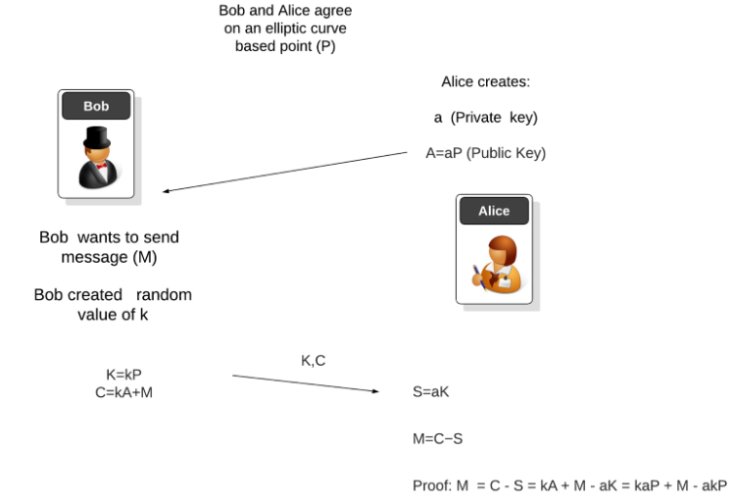
Elliptic ElGamal Cryptosystem Algorithm

Slide 53
Factorization Using Elliptic Curves
Pollards P-1 Factorization
Let N = p1, p2....pr be a number to be factored. Pollard’s p-1 Factorization Algorithm works if one of the primes pk dividing N has the property that pk - 1 itself factors as
p_{k} -1 = L₁^{e1} L₂^{e2} . . . L_{r}^{er} with L₁,…..L_{r} small
if l1, . . . , lr ≤ B, then there is a good chance that
gcd (2^{LCM(1,2,….B)} -1,N) with equal pk
The idea underlying Pollard’s p-1 Algorithm is the fact that every element of Z/pZ∗ has order dividing p-1
Unfortunately, if no p-1 is ”B-smooth”, then Pollard’s method does not work

Slide 54
Factorization Using Elliptic Curves
Hendrik Lenstra observed that one can replace the multiplicative group F∗ p with an elliptic curve group E(Fp).
More precisely, choose an elliptic curve modulo N and a point on the curve: E : y^2 = x^3 + ax + b, a, b ∈ Z/NZ, S ∈ E(Z/NZ)
Suppose that there is a prime p dividing N for which the number of points in E(Fp) is B - smooth.
Then there is a good chance that during the computation of
LCM(1, 2, . . . , B)S mod N
some inverse (x2 - x1)^-1 mod N will not exist, yielding
gcd(x2 - x1, N) = p

Slide 55
Lenstra’s Algorithm
Properties of Lenstra’s Algorithm
The advantage of Lenstra’s Elliptic Curve Algorithm over Pollard’s p-1 Algorithm is the introduction of many finite groups E(Fp) with many different orders.
The theoretical running time of Lenstra’s Algorithm can be calculated using a reasonable assumption about the distribution of B-smooth numbers in short intervals
Let p the smallest prime dividing N. Then the expected running time of Lenstra’s algorithm is
O(e^c√(log p)(loglog p))
The fact that the running time depends on the smallest prime divisor of N makes Lenstra’s algorithm especially good for factoring random numbers, but it is slower than sieve methods for RSA-type numbers N = pq

Slide 56
Lenstra’s Algorithm Working 1/2
First we define the moving from a point P on an elliptic curve to 2P.
find the tangent to the point P and use this to find 2P
This tangent will be defined with a slope (s) and with a gradient in the form of a/b.
For this we must find the modular inverse of b
If we cannot find the modular inverse of b, a factor of N is gcd(N,b)
Our curve is y^2 = x^3 + ax + b
The slope (s) will be: s = (3x^2 + a)/(2y)
pick a random point P = (x0, y0) on an elliptic curve
We also select a random value of A and then calculate: B = y0^2 - x0^3 - Ax (mod N)
For two points on the curve: P = (Px, Py) and Q = (Qx, Qy) , the slope of the line between them will be: s = (Py - Qy)(Px - Qx)

Slide 57
Lenstra’s Algorithm Working 2/2
With this we have s in the form of a/b(mod N)
Next we define: R = P + Q = (Rx, -Ry)
using these :
s = (Px - Qx)(Py - Qy) (mod N) Rx = s2 - Px - Qx (mod N) Ry = Py + s(Rx - Px) (mod N)
If Px = Qx and Py = -Qy, we define as 0 [Identity], else we calculate R = P + P = 2P = (Rx, -Ry)
and finally we have :
s = (3Px^2 + A)/(2Py) (mod N) Rx = s2 - 2Px (mod N) Ry = P + s(Rx - Px) (mod N)

Slide 58
Lenstra’s Algorithm Results
p=15 (Factors: 3 and 5)
p=6,161 (Factors: 61 x 101)
p=32,128 (Factors: 64 x 502)
p=53,421 (Factor: 3 x 17,807)
p=55,440 (Factors: 2 x 2 x 2 x 2 x 3 x 3 x 5 x 7 x 11)
p=100,001 (Factor: 3 and 17,807)
p=999,999 (Factor: 3 x 3 x 3 x 7 x 11 x 13 x 37)
p=455,839 (Factor: 559 and 761)

Slide 59

Elliptic Curve Digital Signature Algorithm (ECDSA)

Slide 60
Basic Concepts
Digital signature (DS) - the requisite of the electronic document, which serves to determine the source of data and protect the document from forgery. To obtain an DS, a cryptographic transformation of an electronic document is performed, which is then attached to the document or logically combined with it. This makes it possible to confirm its integrity and identify the signer.
The Digital Signature Algorithm (DSA) is a Federal Information Processing Standard for digital signatures, based on the mathematical concept of modular exponentiation and the discrete logarithm problem.
In cryptography, the Elliptic Curve Digital Signature Algorithm (ECDSA) offers a variant of the Digital Signature Algorithm (DSA) which uses elliptic curve cryptography.

Slide 61
Digital signature schemes
SHEME | TASK | HASH FUNCTION
RSA | Factoring a number | MD4 or MD5 (Message Digest Algorithm - message summary algorithm, R. Rivest)
DSS (NIST. FIPS Publication 186: Digital Signature Standard (DSS). May 1994) DSS – US Federal Digital Signature Standard | Discrete logarithm according to El-Gamal's scheme | SHA-1 (NIST. FIPS Publication 180: Secure Hash Standard (SHS). May 1993) SHS – USA standard hash function SHA - Secure Hash Algorithm – hash function algorithm
ECDSA (Elliptic Curve Digital Signature Algorithm) | Discrete logarithm in a group of points of an elliptic curve | SHA (NIST. FIPS 180-3: Secure Hash Standard (SHS). October 2008)

Slide 62
Properties of digital signature
1) Authenticity, convincing that it was this person who signed the document.
2) Uniqueness, since a hand signature is a part of a document that cannot be moved to other documents. That is, any individual document will have its own unique digital signature.
3) The integrity of the signed document, i.e. the impossibility of changing the signed document.
4) Non-repudiation of authorship or agreement with the content of the document, the signature cannot be refused in the future.

Slide 63
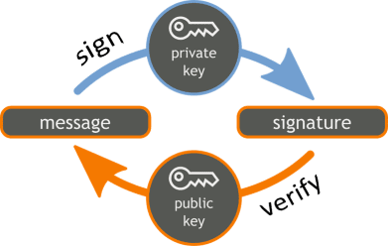
ECDSA
The ECDSA algorithm uses an elliptic curve and a finite field to create a data signature so that third parties can verify the authenticity of the signature and the signer retains the exclusive ability to create the signature.

Slide 64
Benefits of ECDSA over DSA
ECDSA allows you to work on fields significantly smaller than the prime Galois fields GF p(). It is assumed that the bit size of the public key in ESDSA is equal double the size of the secret key in bits. For comparison, with a security level of 80 bits the attacker needs to verify 2 ^ 80 versions of the signature to find the secret key. Moreover, the size the DSA public key is 1024 bits, while for ECDSA public key - 160 bits. On the other hand the signature size is the same for both DSA and ECDSA: 4tbit, where t is the security level measured in bits, that is, with a security level of 80 bits approximately 320 bits for DSA and 80 bits for ECDSA.

Slide 65
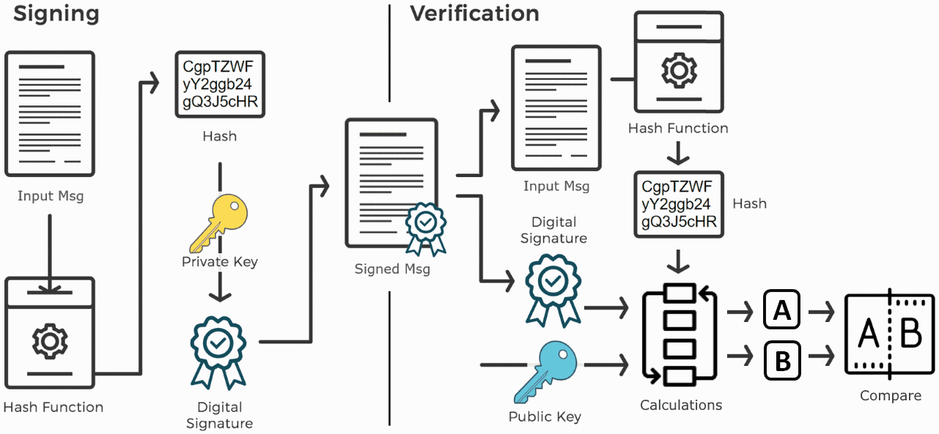
General scheme

Slide 66
One-way functions. Hash functions
One way function is a mapping X → Y, where X and Y are arbitrary sets, satisfying the following conditions:
1. For each x from the domain of the function f, it is easy to calculate f (x). The term "easy" usually means that there is an algorithm that computes the function f (x) in polynomial time in the length of the argument x.
2. The problem of finding the inverse image of x for an arbitrary y, belonging to the range of values ​​of the function f is computationally challenging. This means that there is no there is an algorithm that computes much faster than an exhaustive search algorithm.
Hash functions play an important role in information security, creating a "snapshot" of an electronic document and thereby protecting the document from further modification or substitution. In a broad sense, a hashing function is a function H satisfying the following main properties:
1. The hash function H can be applied to a data block of any length.
2. The hash function H creates an output of a fixed length (equals, for example, 128 bits for the classic MD5 hashing function, and 160 bits for the US standard SHA1 hash functions).
3. The value H = h (M) is calculated relatively quickly (for polynomial time in message length M).
4. For any given value of the hash code H, it is computationally impossible to find M such that h (M) = H.
5. For any given y, it is computationally impossible to find x such that y = h (x).
6. It is computationally impossible to find an arbitrary pair (x, y) such that H (y) = H (x).

Slide 67
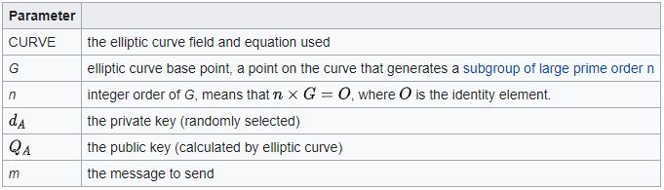
Signature generation algorithm
Suppose Alice wants to send a signed message to Bob. Initially, they must agree on the curve parameters (CURVE,G,n). In addition to the field and equation of the curve, we need G, a base point of prime order on the curve; n is the multiplicative order of the point G. The order n of the base point G must be prime.

Slide 68
Signature generation algorithm
Alice creates a key pair, consisting of a private key integer dA, randomly selected in the interval [1,n-1]; and a public key curve point QA=dA x G. We use x to denote elliptic curve point multiplication by a scalar.
For Alice to sign a message m, she follows these steps:
Calculate e = HASH(m). (Here HASH is a cryptographic hash function, such as SHA-2, with the output converted to an integer.)
Let z be the Ln leftmost bits of e, where Ln is the bit length of the group order n.
Select a cryptographically secure random integer k from [1,n-1].
Calculate the curve point (x1,y1)=k x G.
Calculate r=x1 mod n. If r=0, go back to step 3.
Calculate s=k-1 (z+rdA) mod n. If s=0, go back to step 3.
The signature is the pair (r,s). (And (r,-s mod n) is also a valid signature.)
As the standard notes, it is not only required for k to be secret, but it is also crucial to select different k for different signatures, otherwise the equation in step 6 can be solved for dA.

Slide 69
Signature verification algorithm
For Bob to authenticate Alice's signature, he must have a copy of her public-key curve point QA. Bob can verify QA is a valid curve point as follows:
Check that QA is not equal to the identity element O, and its coordinates are otherwise valid
Check that QA lies on the curve
Check that n x QA=O
After that, Bob follows these steps:
Verify that r and s are integers in [1,n-1]. If not, the signature is invalid.
Calculate e =HASH (m), where HASH is the same function used in the signature generation.
Let z be the Ln leftmost bits of e.
Calculate u1=zs^-1 mod n and u2 = rs^-1 mod n.
Calculate the curve point (x1, y1) = u1 x G +u2 x QA. if (x1, y1) = O then the signature is invalid.
The signature is valid if r ≡ x1 mod n, invalid otherwise.

Slide 70
Digital signature in practice
It should be said that the electronic signature is used more often than you might imagine. In banks, tax, trade and procurement operations, accounting, government services - all these organizations use or implement EDS.
An electronic signature is used in cryptocurrencies, in particular in Bitcoin. Each Bitcoin user has a private and public key pair. The hash value of the public key serves as the primary address for the transfer of coins. This value is not secret, and you can tell it to anyone. But it is impossible to calculate the value of the public key from the hash value. The key pair itself will only be used once - when transferring ownership. This is where the life of a pair of keys ends.

Slide 71
Security
In December 2010, a group calling itself fail0verflow announced recovery of the ECDSA private key used by Sony to sign software for the PlayStation 3 game console. However, this attack only worked because Sony did not properly implement the algorithm, because k was static instead of random. As pointed out in the Signature generation algorithm section above, this makes solvable, rendering the entire algorithm useless.
On March 29, 2011, two researchers published an IACR paper demonstrating that it is possible to retrieve a TLS private key of a server using OpenSSL that authenticates with Elliptic Curves DSA over a binary field via a timing attack. The vulnerability was fixed in OpenSSL 1.0.0e.
In August 2013, it was revealed that bugs in some implementations of the Java class SecureRandom sometimes generated collisions in the k value. This allowed hackers to recover private keys giving them the same control over bitcoin transactions as legitimate keys' owners had, using the same exploit that was used to reveal the PS3 signing key on some Android app implementations, which use Java and rely on ECDSA to authenticate transactions.

Slide 72
Conclusion
The Elliptic Curve Digital Signature Algorithm (ECDSA), which is a variant of Elliptic Curve Cryptography (ECC), is widely used in the modern world. The main reason for the popularity of ECDSA is that there is no known sub-exponential algorithm for solving the discrete logarithm of an elliptic curve on a properly selected elliptic curve. Hence, the solution requires exponential time used in other known integer factorization solutions like RSA and discrete logarithm in DSA. Keys are more secure and consume a lot of bandwidth due to the small key size. ECDSA can use significantly lower parameters than other competing systems such as RSA and DSA, but with equivalent levels of security. Some of the benefits of using smaller keys include faster computation times and reduced processing power, memory, and bandwidth. This makes ECDSA ideal for challenged environments. These benefits are especially important in other environments where there is a lack of processing power, storage space, bandwidth, or power consumption.

Slide 73
References
https://avinetworks.com/glossary/elliptic-curve-cryptography/
https://www.secg.org/
https://en.wikipedia.org/wiki/Elliptic_Curve_Digital_Signature_Algorithm
https://scialert.net/fulltext/?doi=jse.2007.1.12

